Slide 1
Final Project Embedded System for E-Health
Apicella Salvatore, Bove Simone, Cascone Maria a.y. 2022/23

Slide 2
INTRODUCTION
As final project of the course we must to crate with STM32 a smart medical device avoid to monitoring and raise an alert about temperature, heart rate and blood oxygen rate.

Slide 3
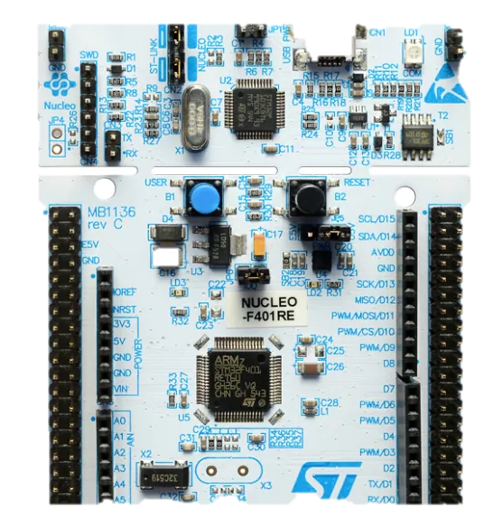
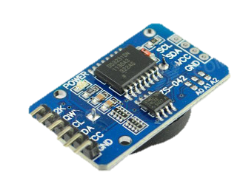
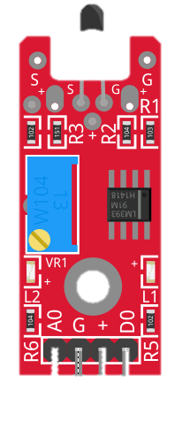
NUCLEO F4 AND PERIPHERALS
DS1307
SSD1306
External CLock
Oled screen
KY028
MAX32664
Temperature ADC sensor
HR and SPO2 Sensor
NUCLEO F401RE
LED
BUZZER
The main board

Slide 4

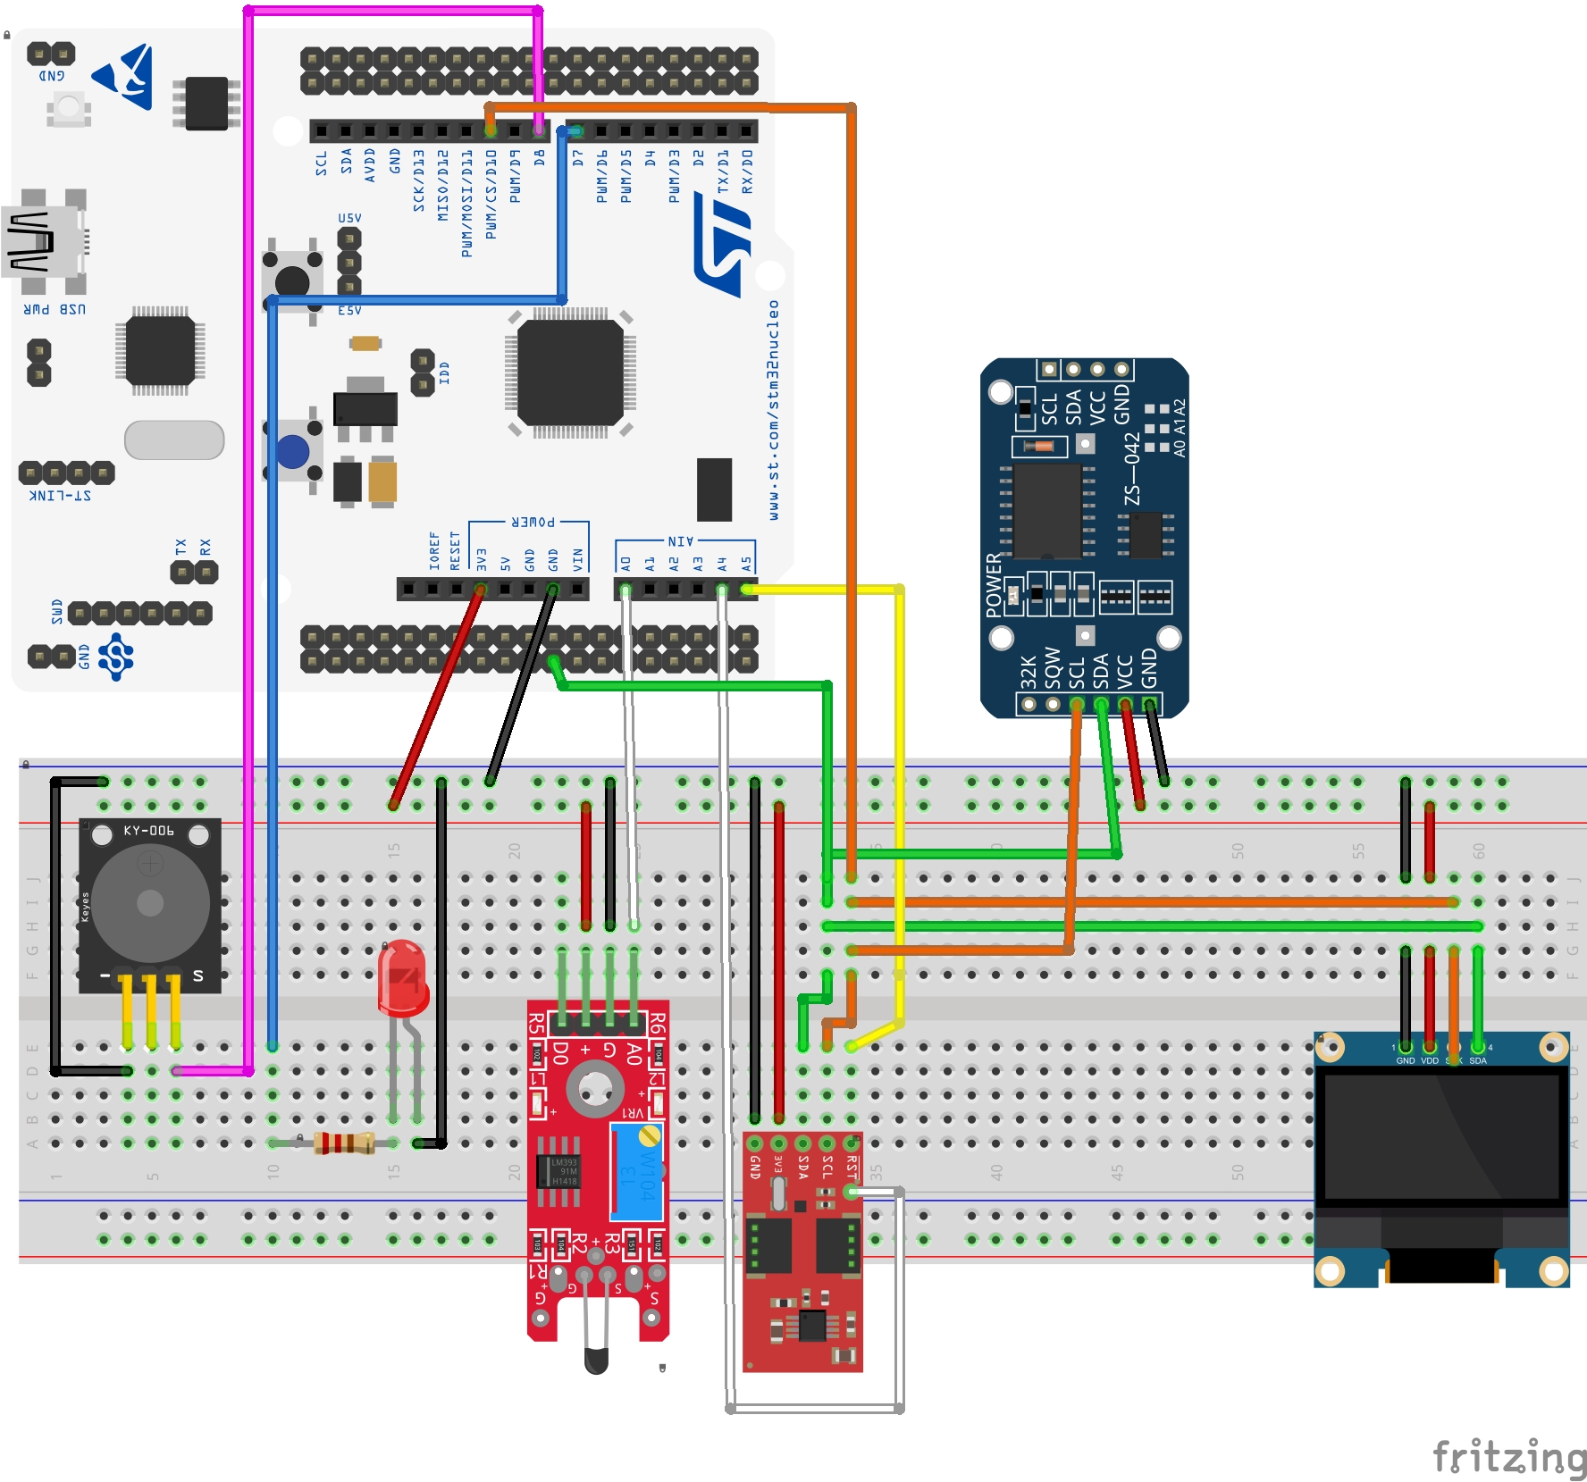
Circuite in Fritzing

Slide 5
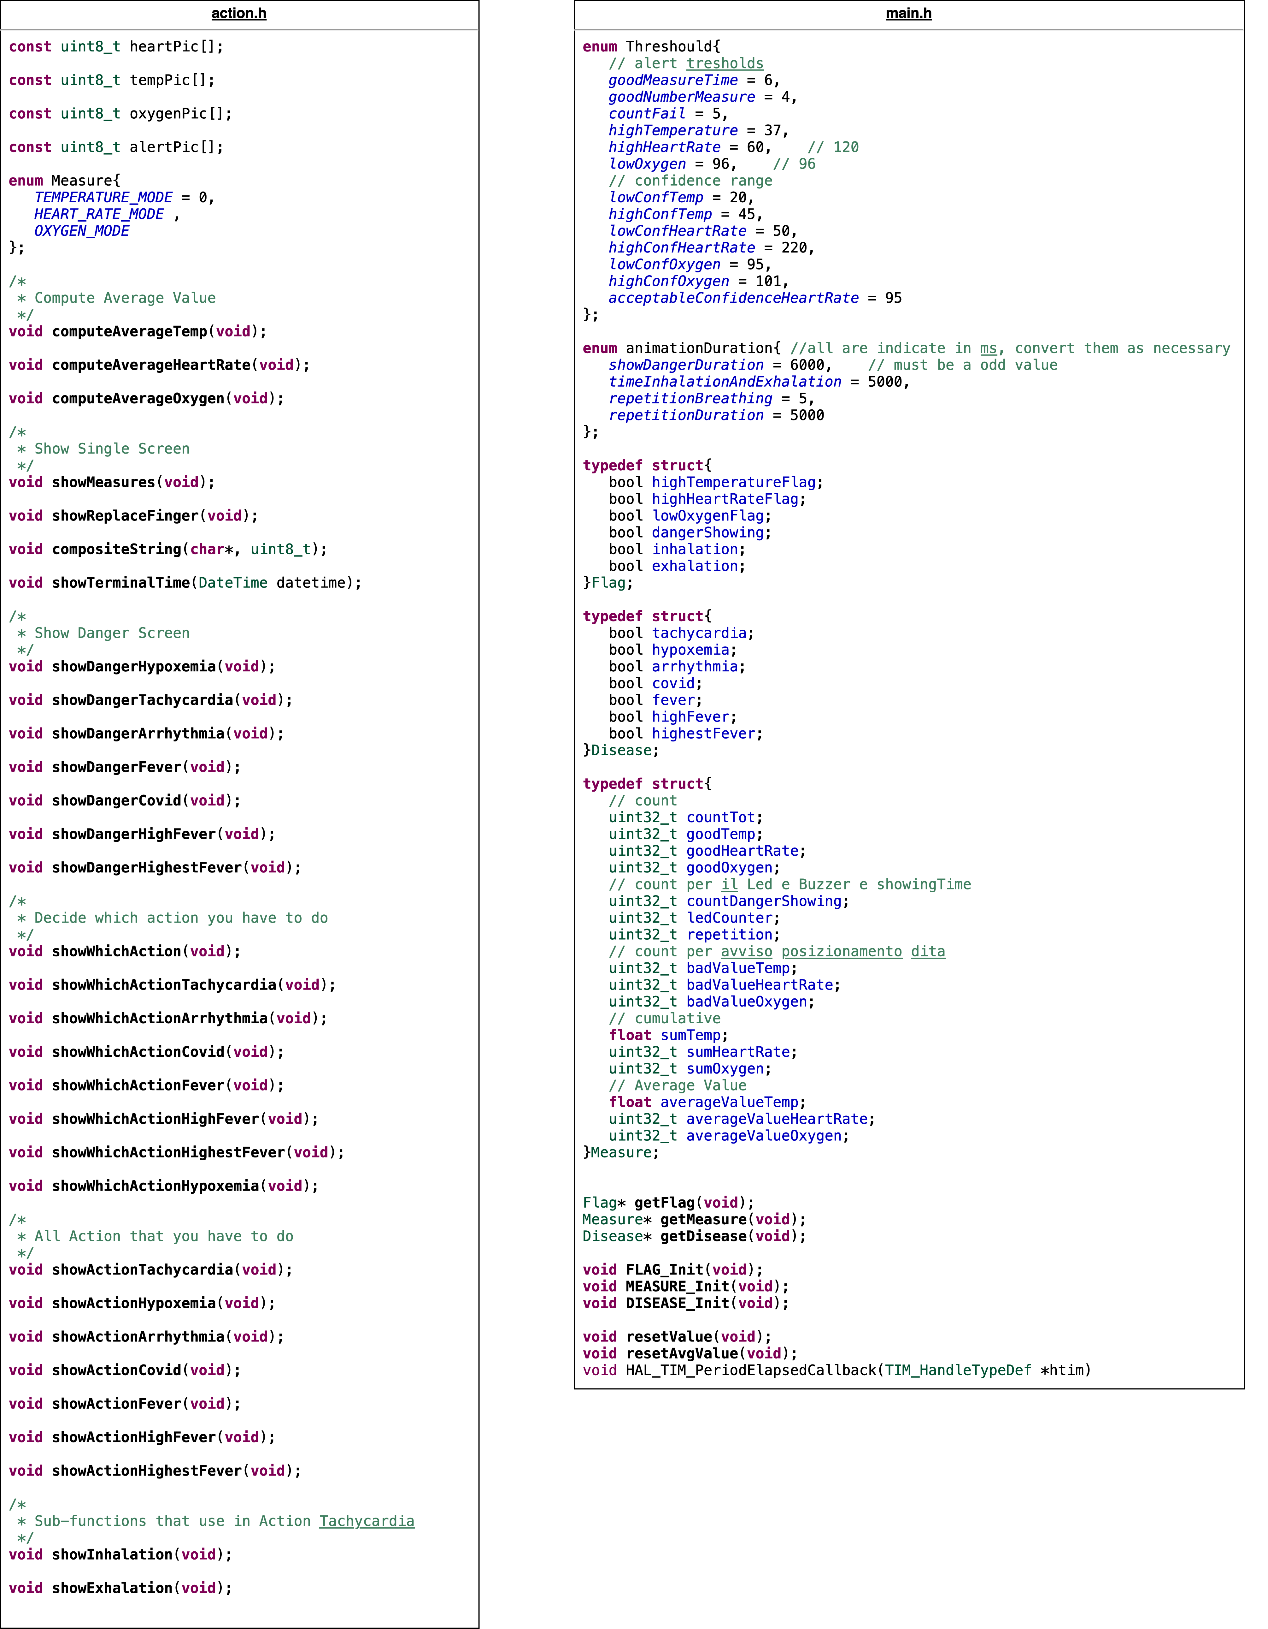
SW ARCHITECTURE
USE OF SINGLETON
USE TIM CALLBACK
NEVER USE WHILE(1)

Slide 6
USE OF SINGLETON

Slide 7
SW INTERFACES
01
02
03
UART
TIM 1 FOR PWM
TIM 10
Used for debug, baud rate 9600 bits/s
2 different channels set by code, used to pilot led and buzzer
To generate an interrupt every second: pre scale 1599, period 9999
04
05
06
TIM 11
ADC
I2C
To generate an interrupt every millisecond: pre scale 1, period 7999
For temperature sensor, Continuos Conversion Mode
Only one bus is used for pilot 3 devises

Slide 8
TIM 10
SW PROTOCOLS
MAIN IF STATEMENT
if (htim->Instance == TIM10){}
if (htim->Instance == TIM11){}
READ DATA
TRIGGER FLAG
RAISE ALERT
TIM 11
MANAGE ANIMATION

Slide 9
POWER DISSIPATION
Device | Power | Energy
NUCLEO | 29.43 mW | 1340 mWh
KY028 | 0.080 mW
MAX32664 | 1305 mW
SSD1306 | 1.419 mW
DS1307 | 4.95 mW
LED | 7.5 mW | 0.125 mWh for cycle
BUZZER | 13.61 mW | 0.019 mWh for alarm

Slide 10
THANKS!
Do you have any questions?

